Slide 1



SAE NIS EFFI-CYCLE 2017 >>>Drive Excellence Season<<< MARKETING PRESENTATION
17057
AARYANS
Walchand college of engineering ,
Sangli (Maharashtra)
Place College/ Team Logo within this space

Slide 2
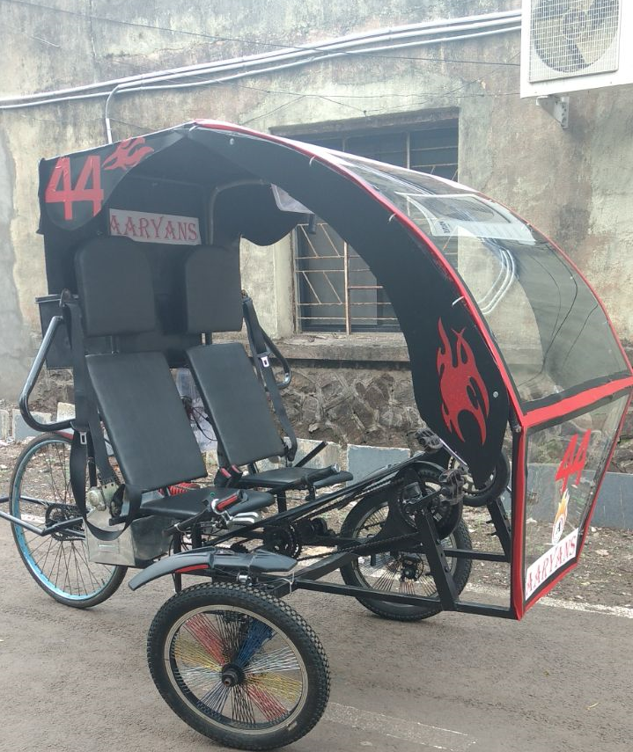
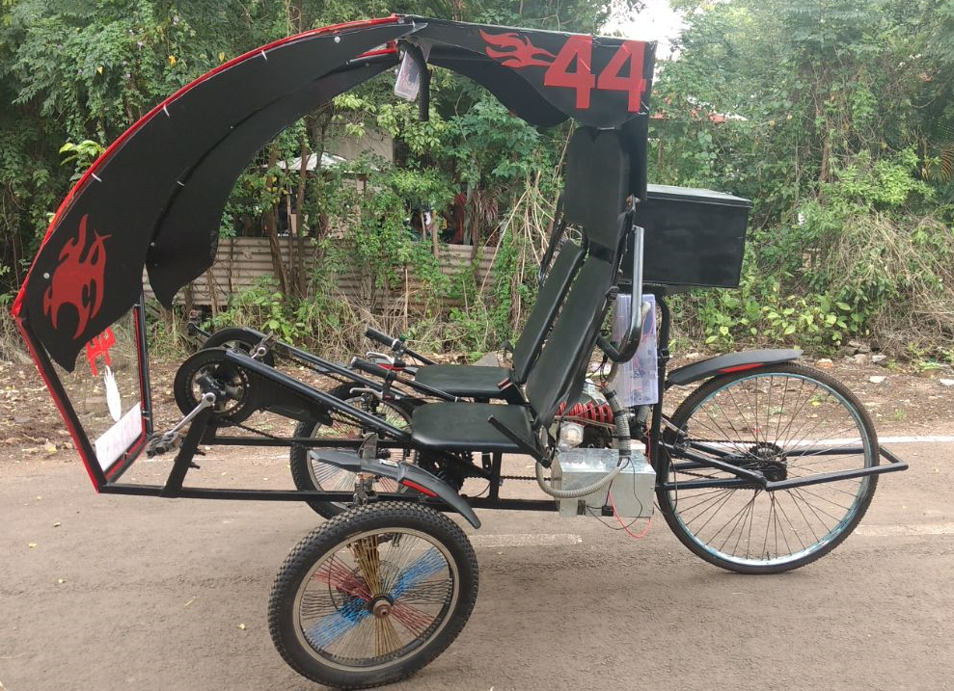
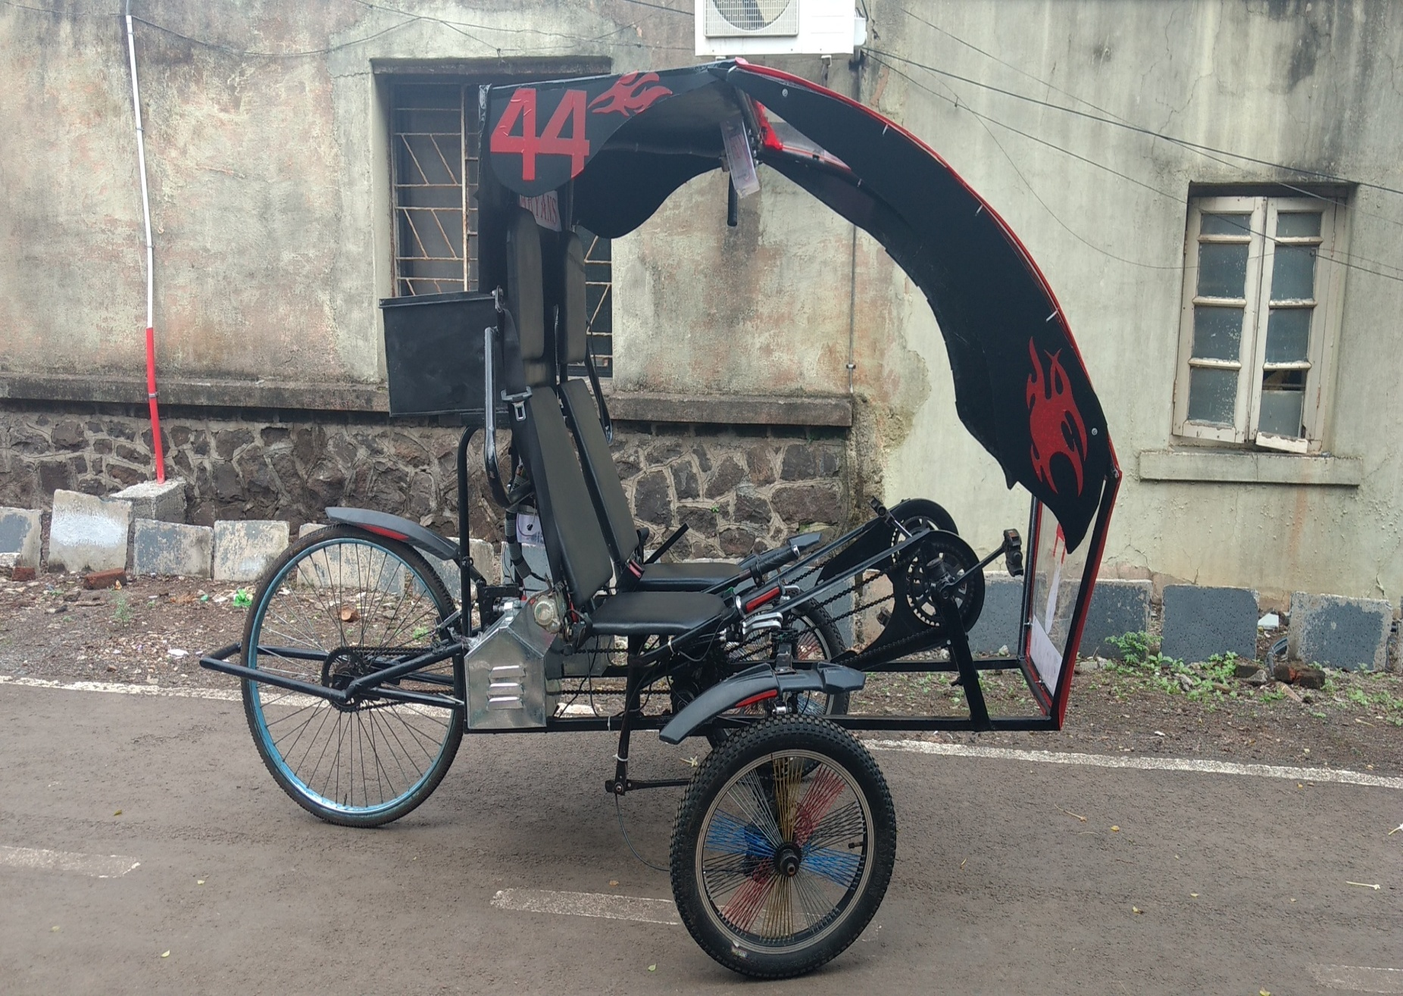
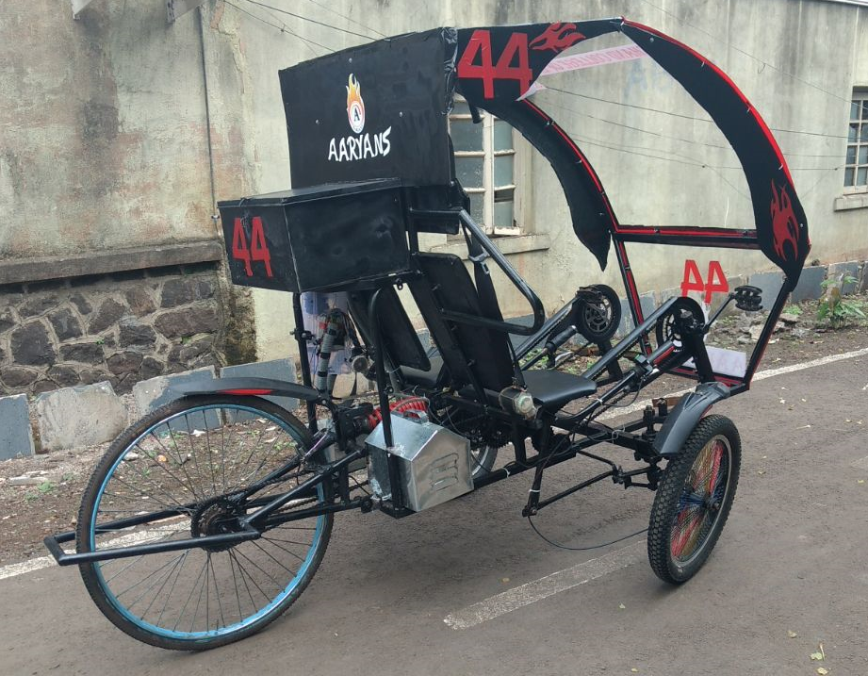
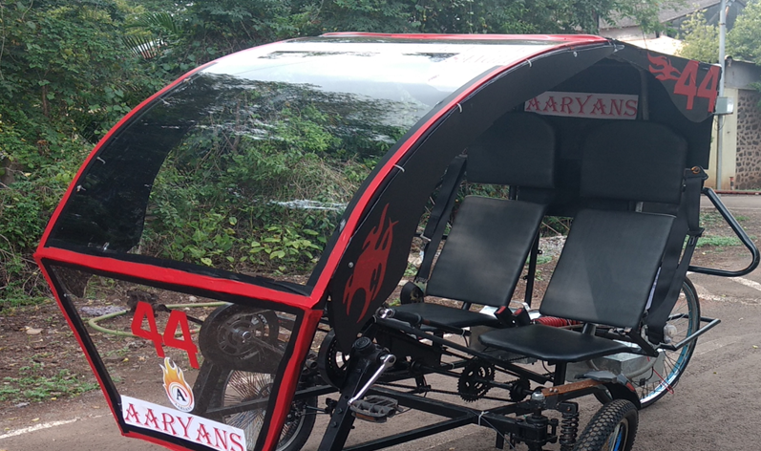
VEHICAL VIEWS

Slide 3
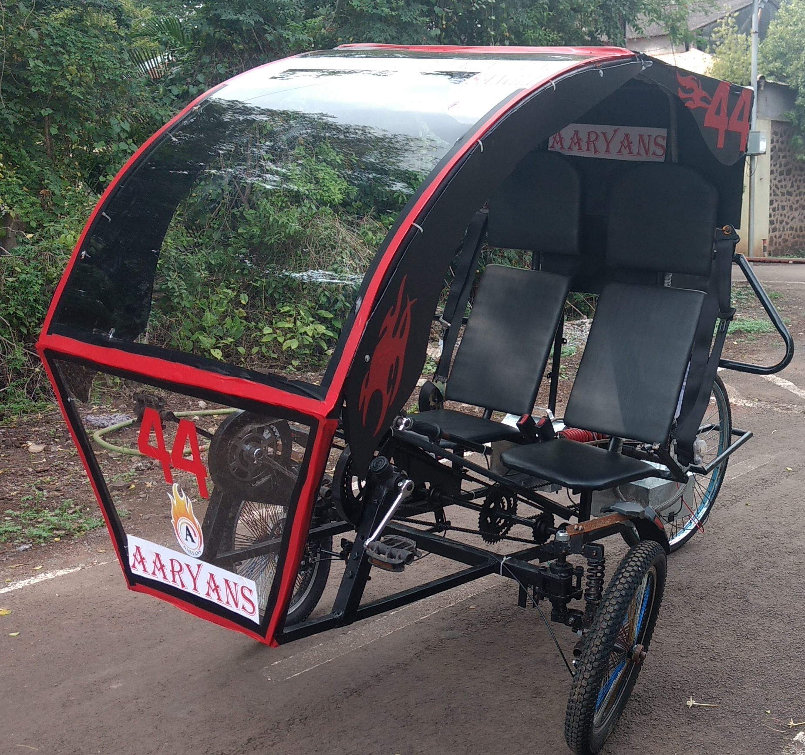
FEATURES OF VEHICLE
SIDE SEATED TADPOLE HYBRID TRIKE
94.5” LENGTH AND 54” WIDTH
FRAME MATERIAL: AISI 1018
UNDERSEAT STEERING WITH 1.5 METER TURNING RADIUS
48V 20AHr LITHIUM ION BATTERY
48V 400W BLDC MOTOR
STEERING GEOMETRY : ACKERMAN
FRONT WHEEL : DISK BREAK
RARE WHEEL : SHOE BREAK
RARE MONOSUSPENSION

Slide 4
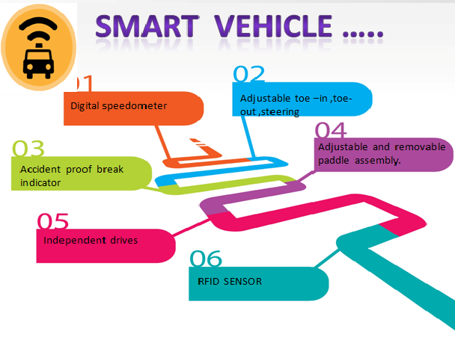
UNIQUE SELLING PROPOSITIONS
UPS
AREODYNAMIC; ERGONOMIC; AESTHETIC
LOW
CARBON
FOOTPRINTS
COMFERTABLE RECUMBENT DESIGN
HIGH PERFORMA-NCE ELECTRIC MOTOR
COMPACT,
MAINTAINENE FREE
Li -ION BATTERY
3Hrs OF
BATTERY
BACKUP
Only
10
paisa / km

Slide 5
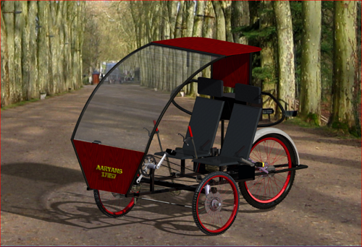
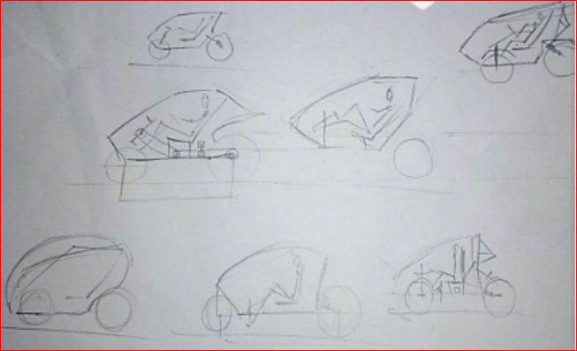
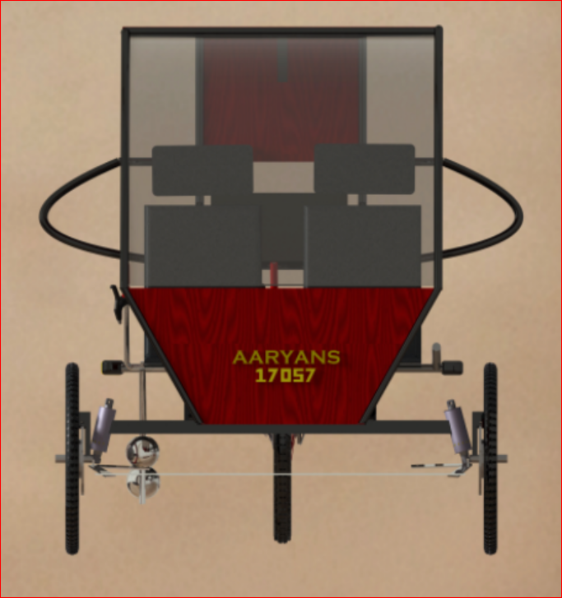
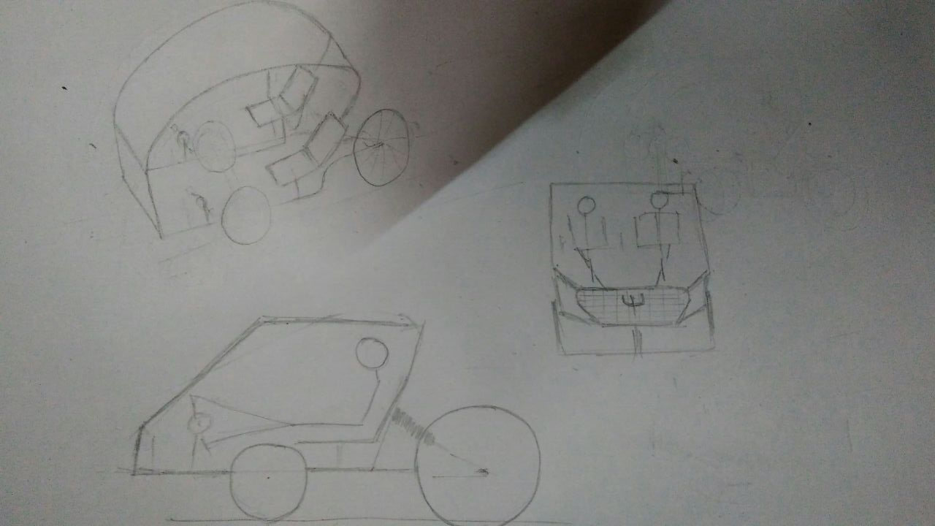
CONCEPT AND VARIENTS
BEST PRICE = Rs.48000

Slide 6
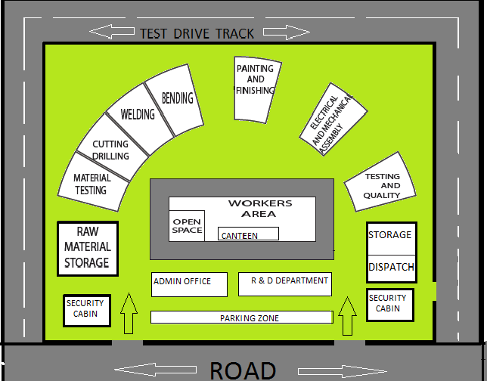
PLANT LAYOUT

Slide 7
COST IN MASS PRODUCTION
SYSTEM | ACTUAL COST | MASS PRODUCTION COST
MATERIAL AND FRAME | 3000 | 1500
DRIVE TRAIN | 41000 | 30000
STREEING | 700 | 325
SUSPENSION | 3000 | 1800
BRAKES | 1100 | 800
WHEELS AND TYRES | 70000 | 3000
SEAT | 1200 | 600
MISCELLANEOUS | 5500 | 2000
TOTAL | 62500 | 40025
TOTAL COST OF VEHICLE IN MASS PRODUCTION Rs. 40025

Slide 8
Break Even Analysis
Fixed cost analysis:
Expenses | Cost (INR)
Land owning | 1,00,00,000
2. Infrastructure and furniture | 70,00,000
3. Procurement of machine tools | 6,25,000
4. Corporate social responsibilities | 1,25,000
5. Insurance and policies | 2,00,000
6. Inventory management | 10,00,000
7. Recruitment and wages | 56,94,000
8. Dispatch and logistics | 30,00,000
9. Maintenance | 3,00,000
10. Marketing and advertisement | 8,00,000
11. Canteen facilities | 75,000
12. Energy consumption cost | 5,00,000
Break even point for mass production of vehicle lies at production rate of 3676 vehicles per year.
Variable Cost:
Cost of Manufacturing a Vehicle | 40025

Slide 9
PROMOTIONAL STRATEGIES
FOR You you YOU YOU
AIMING BIG
Social Media Branding
Advertising
Test Drives and Demos
GREEN RALEYS
Launch on 5th June under FAME India scheme
LAUNCH
Free Helmet and Goggles
Customer demand Design
Free insurance for a year
THREE years FREE servicing
Online Stores
Showrooms and service centers in Prime cities

Slide 10
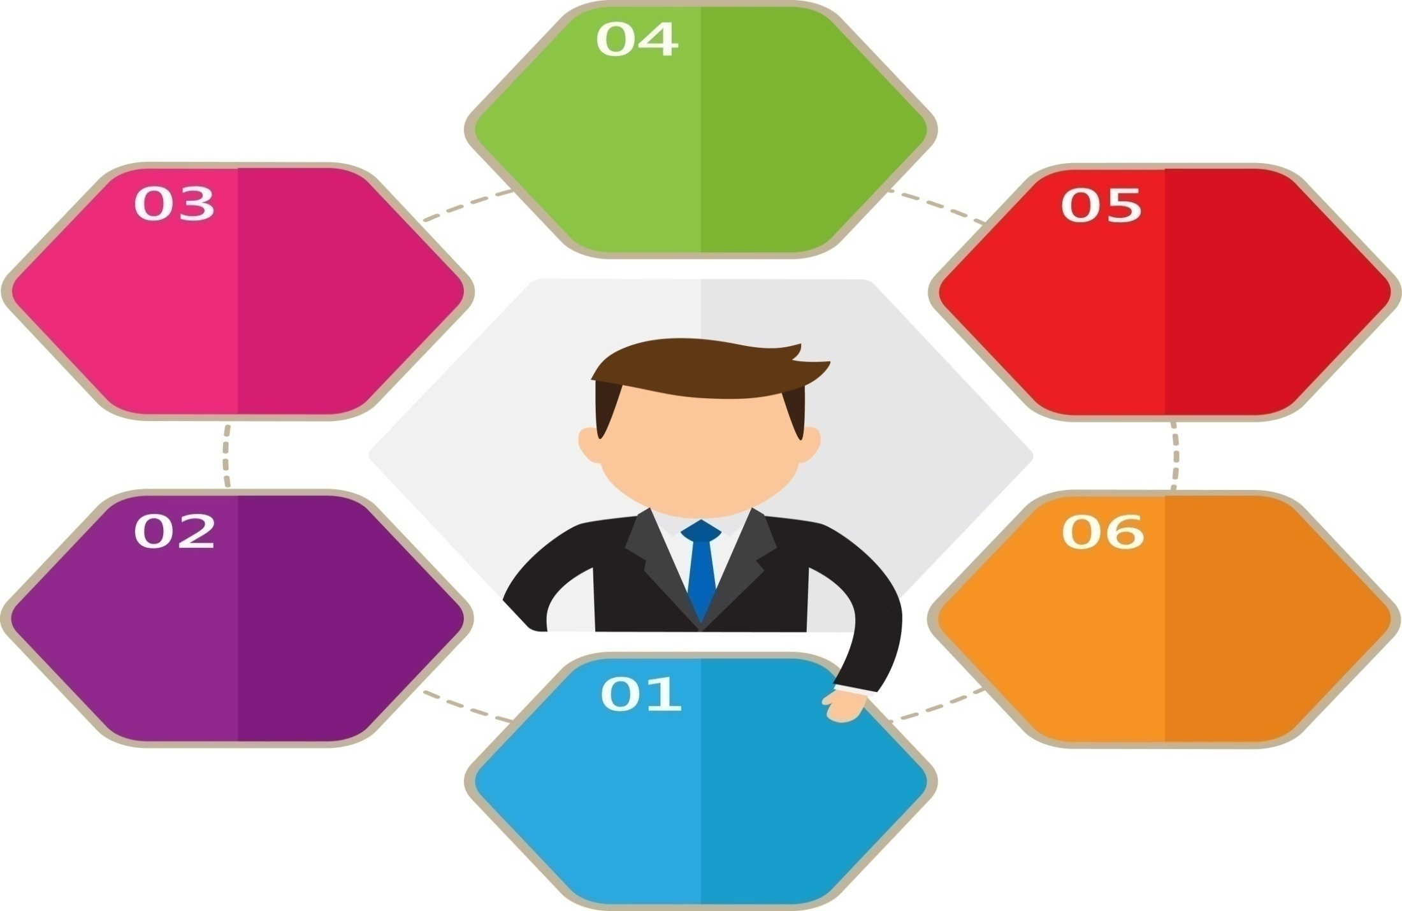
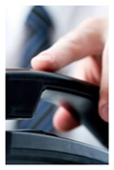



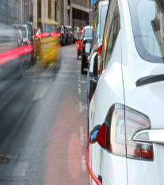
AFTER SALES
Maintenance
of
customer
profiles
“Refer
A
Friend”
Scheme
“Follow
the
car” strategy
One
year Extended Warranty
Monitor
performance
Chat
with Technical Adviser

